Slide 1

What is the AP Capstone Program?

Slide 2
Introducing - AP Capstone
is an innovative program that allows students to engage in rigorous college-level study of the critical skills necessary for success in college. The Program of study includes a two-course sequence:
AP Seminar and AP Research
Emphasizes Critical Skills
Complements the in-depth subject-matter study in AP
Considering multiple perspectives
Careful evaluation of information
Writing evidence-based arguments
Identifying and solving problems
Oral communication and defending an argument
Collaboration and teamwork
Notes:
Beginning in fall 2014, the College Board’s Advanced Placement Program will offer AP Capstone™.
Developed at the request of College Board Higher Education membership and currently being piloted in 17 schools worldwide, AP Capstone is built on the foundation of a new two-year high school course sequence and is designed to complement and enhance the in-depth, discipline-specific study provided through other AP courses.
The AP Capstone curriculum fosters inquiry, research, collaboration, and writing skills through the intensive investigation of topics from multiple perspectives.

Slide 3


AP Seminar – Starting Fall 2014
Typically taken in grade 10 or 11.
Students learn how to:
Exam score based on:
Example Topics
Democracy
Education
Revolution
Freedom
Protest
Technology
Sustainability
Investigate real-world topics from multiple perspectives
Carefully analyze information, write evidence-based arguments and effectively communicate them
Work independently and with a team to research a topic, develop a written report and deliver a presentation
Team Project & Presentation
  25%
2. Individual Essay & Presentation
  35%
Written Exam
  40%
Teachers & Students select and study 2-4 topics.
Notes:
AP Seminar is a foundational course that aims to equip students with the power to analyze and evaluate information with accuracy and precision in order to craft and communicate evidence-based arguments. Using an inquiry framework of questioning, understanding, evaluating, synthesizing, and transforming, students practice reading and analyzing articles, research studies, foundational, literary, and philosophical texts; listening to and viewing speeches, broadcasts, and personal accounts; experiencing artistic works and performances; conducting research and evaluating evidence; constructing and supporting arguments; and collaborating and communicating. The course topics and themes engage students in cross curricular conversations that explore the complexities of academic and real-world topics and themes through the examination of divergent perspectives.
Students engage in conversations about complex academic and world issues through a variety of lenses, considering multiple points of view to can gain a rich appreciation for and understanding of the complexity of important issues. Teachers have the flexibility to choose 2-4 appropriate topics or themes that allow for deep exploration based on:
Students are assessed through two through-course performance assessment tasks and a written exam. The following assessments are summative and will be used to calculate a final AP Score (using the 1-5 scale) for AP Seminar.

Slide 4


AP Research – Starting Fall 2015
Students learn how to:
Exam score based on:
Design, plan, and conduct a year-long mentored, research-based investigation
Apply research methods and practices to address a real-world topic selected by the student
Write a college-level research paper, present and orally defend the findings and research methodology
Research Process
  15%
Academic Thesis Paper (~5,000 words)
  70%
Public Presentation and Oral Defense
  15%
AP Seminar is a prerequisite to AP Research.
Notes:
The second course in the Capstone experience allows students to explore deeply an academic topic, problem, or issue of individual interest. Through this inquiry, students design, plan, and conduct a year-long mentored, research-based investigation to address a research question.
In the AP Research course, students further their skills acquired in the AP Seminar course by understanding research methodology; employing ethical research practices; and accessing, analyzing, and synthesizing information as they address a research question. The course culminates in an academic thesis paper of approximately 5,000 words and a presentation, performance, or exhibition with an oral defense.
AP Seminar is a prerequisite to AP Research.

Slide 5
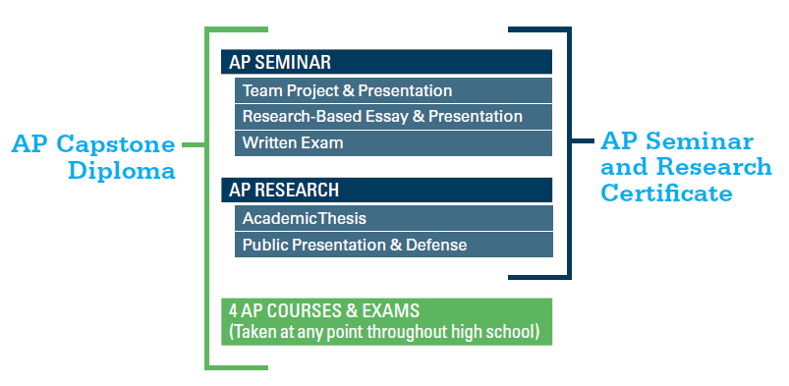
AP Capstone Program Model
A two-course sequence that provides students with the critical thinking and research skills needed to succeed in college and stand-out in the admission process
AP Capstone Diploma™
AP Research & Seminar Certificate™
Students who earn scores of 3 or higher on the AP Seminar and AP Research Exams and on four additional AP Exams of their choosing will receive the
AP Capstone Diploma™.
Students who earn scores of 3 or higher on the AP Seminar and AP Research Exams only will receive the AP Seminar and Research Certificate™
Notes:
AP Capstone promotes student engagement with rigorous college-level curricula and allows students to choose the AP courses in pursuit of the AP Capstone Diploma.
The AP Capstone Diploma Option provides a framework for students taking multiple AP Courses to distinguish themselves in the college admission process.
The AP Seminar & Research Certificate recognizes students for completing a rigorous college-level curricula which will serve as a foundation for success in college.

Slide 6
AP® Capstone Exam Fees
The exam fees for AP Seminar and AP Research are $139 each.
Assistance is available for eligible students with financial need:
  The College Board offers exam fee reductions for eligible students with financial need.

Slide 7

AP Capstone Program: The Benefits

Slide 8

AP Capstone: The Benefits
Distinction – Stand out in the college admission process and have the opportunity to earn valuable college credit or placement
Critical Skills – Students acquire rigorous college-level analysis, writing, and research skills that are increasingly valued by colleges
Choice – Students choose their own research topic and study issues and topics of interest and importance to them

Slide 9

What Students are saying about AP Capstone
“We get a topic, and we dive deep into it, looking at not just the facts but different perspectives, which ones are strongest, which ones are missing something… [It]…teaches us to learn and think, and prepares us for college and life in a way that no other class does…”
—Senior, North Central High School, Spokane, WA
“The expectations in the [AP Seminar] course are a lot higher. We are expected to be more responsible and more attentive about what is going on in the world around us.”
—Sophomore, N. Miami Beach High School, Miami, FL
“[In college interviews,] it gives you something to talk about. I can be really specific and colleges see that you have an interest.”
-Senior, Brooklyn Technical High School, Brooklyn, NY
“[I’ve gained] confidence… I speak more now. In this environment your opinion is needed. You feel part of a family.”
—Junior, Brooklyn Technical High School, Brooklyn, NY
Notes:
Currently being piloted in 17 schools worldwide, almost 90% of the students involved in the Capstone pilot would recommend it to other students.
Students involved in the pilot overwhelmingly think that that the program :
Helps them see an issue from multiple perspectives
Challenges their thinking
Helps them construct a cohesive argument
Has helped them improve their presentation skills

Slide 10
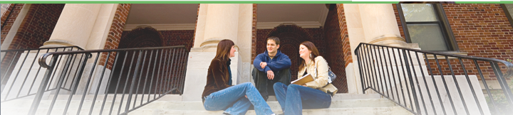
What Colleges are saying about AP Capstone
“At the University of Washington, we would be very interested in enrolling students who have distinguished themselves through the AP Capstone program.”
Phillip Ballinger, Associate Vice Provost for Enrollment and Undergraduate Admissions, University of Washington
“AP Seminar and AP Research are terrific classes that prepare students to think in non-formulaic ways.”
Stuart Schmill, Dean of Admissions, Massachusetts Institute of Technology
“[Through this program] you get students turned on to higher education in a way they are not currently and they enter university with a different kind of attitude.”
Susan Roth, Vice Provost for Interdisciplinary Studies, Duke University, AP Capstone Curriculum Advisory Committee
Notes:
Informed by the pilot and at the request of colleges and university officials, the AP Capstone curriculum and learning objectives are uniquely aligned with core AP skills and practices, and supported by well-researched approaches to skills-based learning.
Piloted in seventeen schools in partnership with the University of Cambridge, the program received remarkable support from the higher education community, including Admissions leaders, Honors Colleges, and Directors of Undergraduate Research.

Slide 11
Support from Colleges
Colleges rank grades in college-preparatory courses and strength of curriculum as the two top factors in the admission decision.
Completing the AP Capstone courses tells college admission officials that students are challenging themselves and preparing for the rigors they'll encounter at their institution and beyond.
AP Capstone is launching in fall 2014 after a successful pilot program conducted in high schools across the globe and supported by over 100 colleges and universities in the U.S. and Canada.
Below is a list of some of the colleges that have conveyed support for the pilot:
Columbia University Davidson College Duke University Florida State University Massachusetts Institute of Technology | New York University Pennsylvania State University University of Maryland University of Michigan | University of Southern California University of Texas at Austin University of Virginia University of Washington Yale University
Visit www.collegeboard.org/apcapstone for the latest list of colleges supporting the AP Capstone program.
Notes:
Presenters are encouraged to include the AP® policies and statements of their own local and state universities where applicable to reinforce the importance of AP classes in the competitive college admission process.
Over 100 colleges and universities have supported the pilot program and College Board expects many more to endorse AP Capstone in the coming months.
Students should check with individual colleges and universities to understand individual campus AP credit and placement policies.

Slide 12
Next Steps: Help Your Child
Make the Best Choices

Slide 13
AP Capstone: Start the Conversation
Help your child prepare to talk to a teacher or counselor about AP Capstone. Here are some questions to encourage your child to think about:
Is AP Capstone right for me?
Before you talk to a teacher or counselor, think about what interests you:
What college majors are you considering? What careers excite you?
Do I enjoy challenging myself to think in new ways?
Do I like to collaborate and learn from others?
Ask your counselor or teacher the following questions:
May I speak with a teacher familiar with AP Capstone?
How will the courses be structured in the school schedule?
Are there other courses that can help me succeed in AP Capstone?
What steps do I need to take?
Go online and read the AP Capstone brochure to find out more
Find out your school’s enrollment deadline and sign up!
Notes:
Presenter: Encourage families to talk openly and realistically with students about the time commitment, challenges, etc., without exaggerating the difficulties. Many students take multiple AP courses and thrive. Others find better success with one or two AP courses, depending on their other school, work and home commitments.

Slide 14
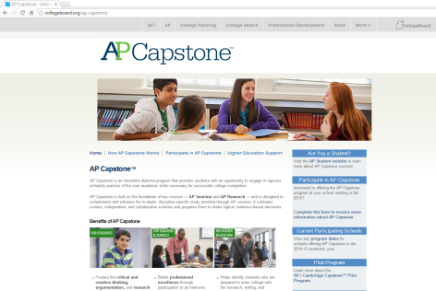
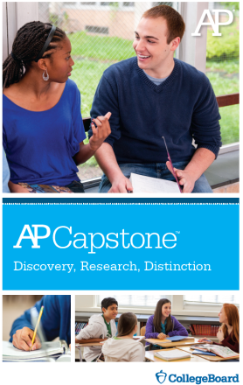
Additional Information about AP Capstone
The AP Capstone Brochure
AP Capstone online: www.collegeboard.org/apcapstone
Direct questions and concerns to:
<AP Capstone POC Name at your school>
<POC Email at your school>
<POC Phone Number at your school>
Notes:
Presenter: Encourage families to explore these resources on their own and with their children as they’re researching college opportunities and options.

